Slide 1
Capstone Project II Predicting individual annual cost of medical insurance by ML method By Lok Hang Ronald, Wong

Slide 2

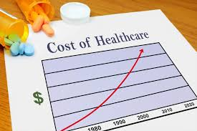
Background Information
Medical cost is one of the largest burdens of Americans
Health care spending per person surpassed $10,000 in 2016
March steadily higher to $14,944 in 2023.
Statistic source from Centers for Medicare and Medicaid Services (CMS)

Slide 3
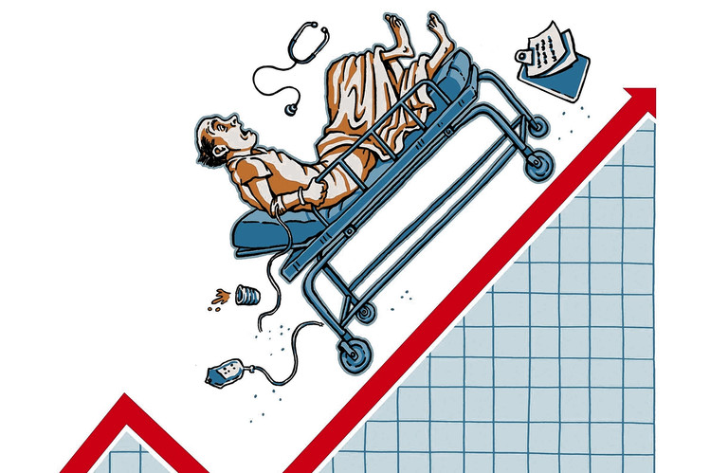

Who might Care?
Start-up Companies
Provide services such as consulting
Finding potential customers
General Public
Evaluation of their current planes
Better planning and strategy
Photo source: http://canonprintermx410.blogspot.com

Slide 4
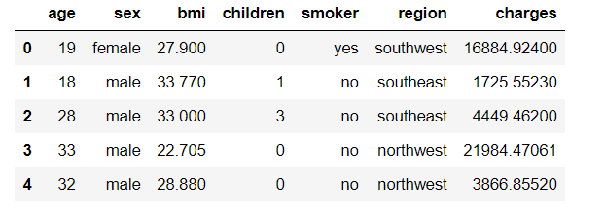
Dataset
1337 customers with their information obtained from Kaggle

Slide 5
Project Outline
Data Wrangling
-Cleaning Data
-Data Quality Checking
Exploratory Data Analysis (EDA)
-Data Visualization
-Statistical Testing
Pre-processing and Training Data
-One-hot encoding
-Data Splitting
Modeling
-Models Comparison
-Model Features Importance
Conclusion
-Predicting Accuracy
-Other Findings

Slide 6
Exploratory Data Analysis (EDA) – t-test
For comparing categorical variable with numerical variable
For 2 unique values in categorical variable
Null Hypothesis: Mean of two groups are the same
Adopted for gender and smoking behavior

Slide 7
Exploratory Data Analysis (EDA) – One-way ANOVA
For comparing categorical variable with numerical variable
For 3 or more unique values in categorical variable
Null Hypothesis: Mean of all groups are the same
Adopted for region and family size (0 to 5 children)

Slide 8
Exploratory Data Analysis (EDA) – chi-squared test
For checking correlation between categorical variables
Similar with heatmap for numerical variables
Null Hypothesis: The categorical variables are not correlated
Findings: Smoker and Gender, bmi and Gender are correlated

Slide 9
Modelling
Approach 1 | Approach 2
Ordinary least squares (OLS) | Random Forest Regressor (RFR)

Slide 10
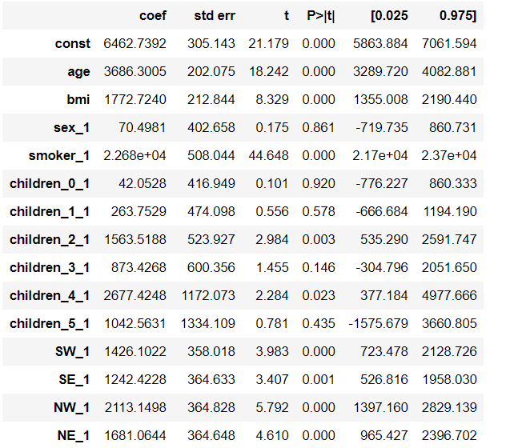
Modelling – Feature Selection
OLS Summary Report

Slide 11
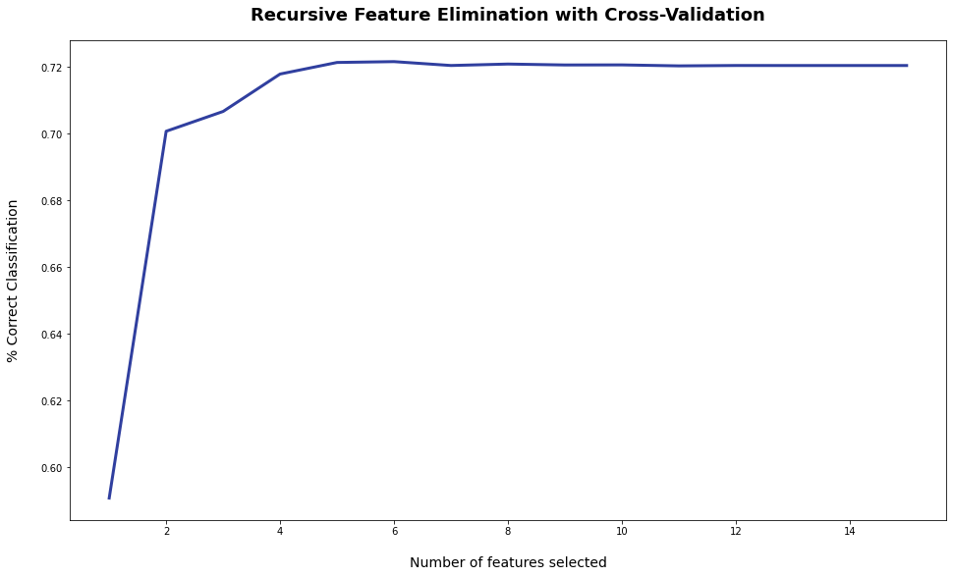
Modelling – Feature Selection
Recursive Feature Elimination and Cross-Validation Selection (RFECV)

Slide 12
Result – OLS Model
Model | R2 Score | RMSE
All Features | 0.786 | 6033
Best 6 Features | 0.643 | 7793
Drop 5 Features | 0.785 | 6042
Best OLS Model

Slide 13
Result – RFR Model
Model | R2 Score | RMSE
All Features | 0.862 | 4840
Best 6 Features | 0.862 | 4844
Best RFR Model

Slide 14
Result –Model Selection
Model | R2 Score | RMSE
Best OLS | 0.785 | 6042
Best RFR | 0.862 | 4844
Selected Model

Slide 15
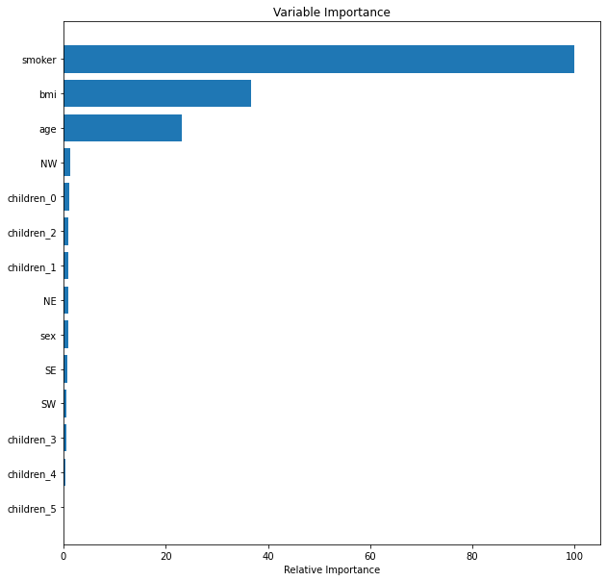
Result –Feature Importance
Adopted in selected model
Not adopted in selected model

Slide 16
Future Studies
Increasing data size to prevent over-fitting
Comprise more customer information (More features)
Comparing more ML methods such as K-NN and Neural Network

Slide 17
Conclusion
Established a model for predicting medical insurance cost
Explored important and non-essential factors
Importance to start-up companies and general public

Slide 18
Q & A

